Slide 1
Services Science & Service Operational Management
CSBS VIII Sem

Slide 2
Service Recovery & Guarantee
Service Recovery

Slide 3
Service Recovery & Guarantee
What is Price Elasticity?

Slide 4
Service Recovery & Guarantee
Price Elasticity
2%
Price (p) INR | Demand (q) QTY
750 | 900
749 | ??
Q = Demand at 750 + (Demand at 750 X Price Elasticity)

Slide 5
Service Recovery & Guarantee
Price Elasticity
2%
Price (p) INR | Demand (q) QTY
750 | 900
749 | ??

Slide 6
Service Recovery & Guarantee
Price (p) INR | Demand (q) QTY
750 | 900
749 | 918
748 | 936
747 | 954
746 | 972

Slide 7
Service Recovery & Guarantee
Price Elasticity
2%
Price (p) INR | Demand (q) QTY
750 | 900
749 | ??
Service Factor
-0.5
Q = Demand at 750 + (Demand at 750 X Price Elasticity) + ((Demand at 750 / penalty factor) X Service Factor)
Penalty factor is between 20 & 80, Consider 45 in this case

Slide 8
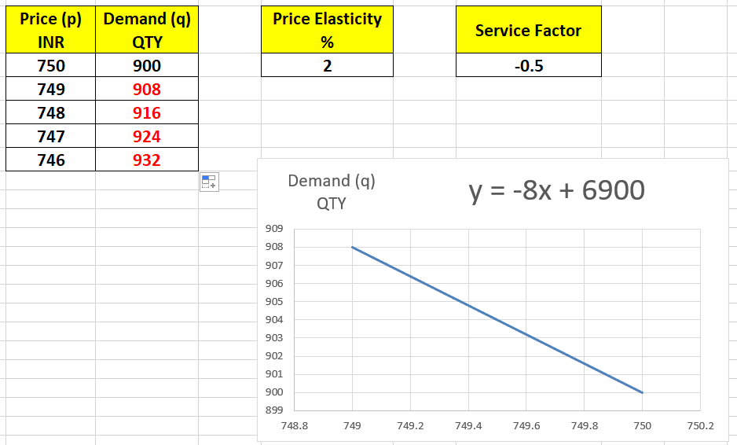
Service Recovery & Guarantee

Slide 9
Service Recovery & Guarantee
Price (p) INR | Demand (q) QTY | (q) Service Factor (-0.5)
750 | 900 | 900
749 | 918 | 908
748 | 936 | 916
747 | 954 | 924
746 | 972 | 932

Slide 10
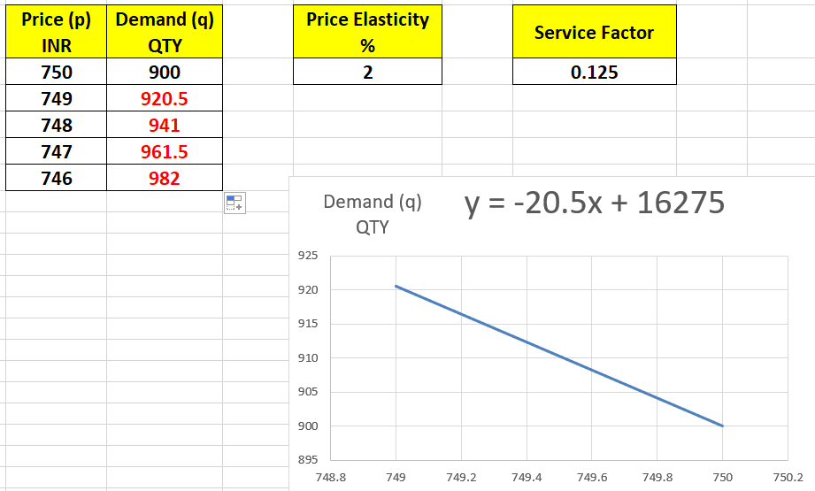
Service Recovery & Guarantee

Slide 11
Service Recovery & Guarantee
Price (p) INR | Demand (q) QTY | (q) Service Factor (-0.5) | (q) Service Factor (0.125)
750 | 900 | 900 | 900
749 | 918 | 908 | 920.5
748 | 936 | 916 | 941
747 | 954 | 924 | 961.5
746 | 972 | 932 | 982

Slide 12
Service Recovery & Guarantee
Service Factor is measured thru Reputation Management (online reviews, surveys etc.)
Service Factor is also the result of “Customer Perception” and “Customer Satisfaction”.

Slide 13
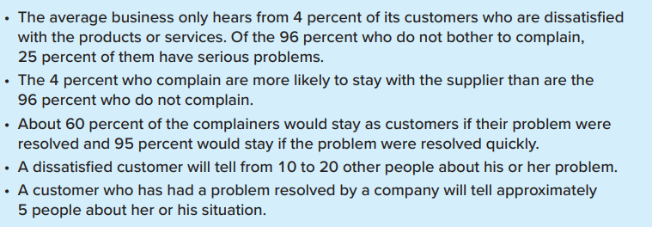
Service Recovery & Guarantee
Customer Feedback and Word of Mouth

Slide 14
Service Recovery & Guarantee
Future of Service Quality is dependent upon BIG DATA
………. Every Service Provider dreams of “Nil” Service failure. So they have adopted pro-active strategies.

Slide 15
Service Recovery & Guarantee
Restaurant:
Consider your meal free if you don't get a bill
Logistic Services:
Do not accept any tampered packages, Call us or WhatsApp at 986XXXXX2X to register your complain

Slide 16
Service Recovery & Guarantee
Customer friendly applications to file and track service complaints efficiently and effectively.
Use Case: Responsiveness – Assurance – Empathy
Failure of kitchen appliance (from filing the complain to service engineer’s visit)

Slide 17
Service Recovery & Guarantee
Learn from lost customer
Use Case: Reliability – Tangible - Responsiveness – Assurance – Empathy
Failure of kitchen appliance (from filing the complain to service engineer’s visit)

Slide 18
Service Recovery & Guarantee
Make the Service Fail-Safe—Do It Right the First Time!
Use of Poka Yokes to improve Reliability. Poka yokes are automatic warnings or controls in place to ensure that mistakes are not made; essentially, they are quality control mechanisms, typically used on assembly lines.
Use Case: Reliability
Aqua Guard

Slide 19
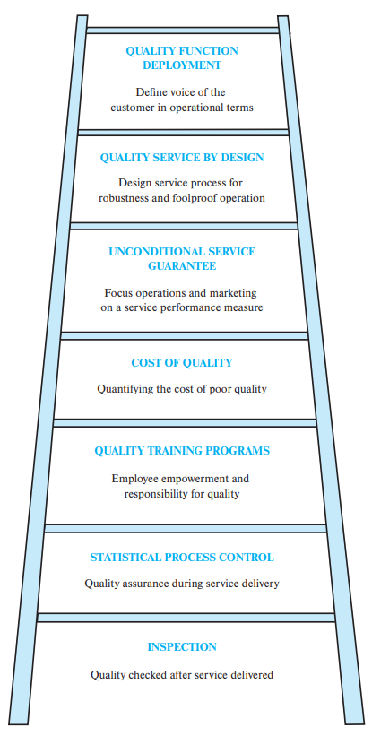
Service Recovery & Guarantee
The Service Quality Ladder

Slide 20
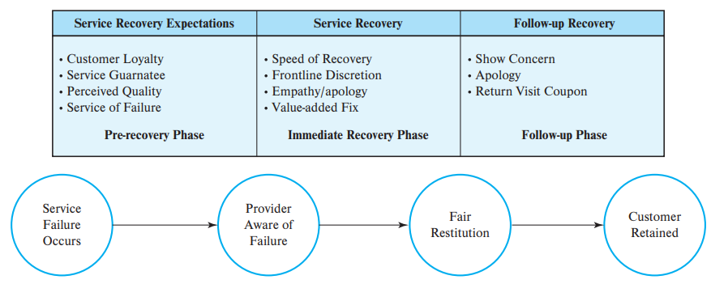
Service Recovery & Guarantee
Phases in Service Recovery

Slide 21
Service Recovery & Guarantee
Approaches to Service Recovery
Case-by-case approach
Systematic-response approach
Early intervention approach
Substitute service recovery

Slide 22
Service Recovery & Guarantee
Medicity Vs Apollo
Customer Perception to Customer Satisfaction

Slide 23
Service Recovery & Guarantee
Service Failure Recovery
Listen to their complain patiently - Apologize
Act self on complaint or delegate it to your team for quick action
Continuous follow up with the customer until complaint is closed

Slide 24
Service Recovery & Guarantee
Guarantee & Warranty
Guarantee
Warranty
The guarantee acts as a promise made by the manufacturer.
The guarantee covers the product, service, people, and consumer satisfaction
Warranty is a written assurance.
Warranty only covers the product / parts of products replacements FOC (free of cost)
How can it be applied to Services?

Slide 25
Service Recovery & Guarantee

Slide 26
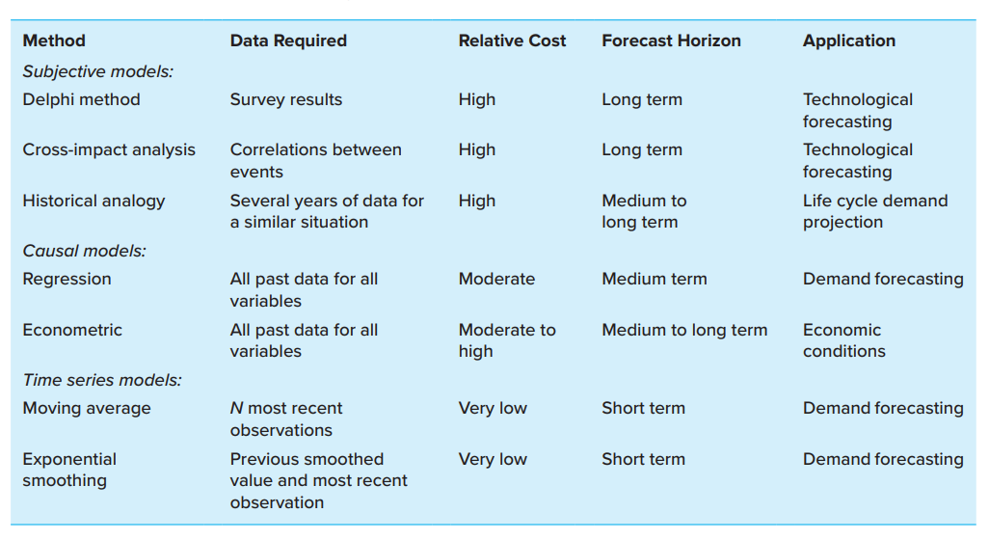
Forecasting Demand for Services

Slide 27
Forecasting Demand for Services
Every time in services Budget is not allocated……… You have to be creative or innovative in developing your own budget.
Example:
JIO Fibre Monthly Subscription:
30 days Rs 470….. If renewal is delayed by 1 day.
30 x 12

Slide 28
Forecasting Demand for Services
Strategies for matching capacity and demand
Level Capacity
Chase Demand

Slide 29
Forecasting Demand for Services
Strategies for matching capacity and demand
Level Capacity
Chase Demand
Manage Demand
Manage Capacity

Slide 30
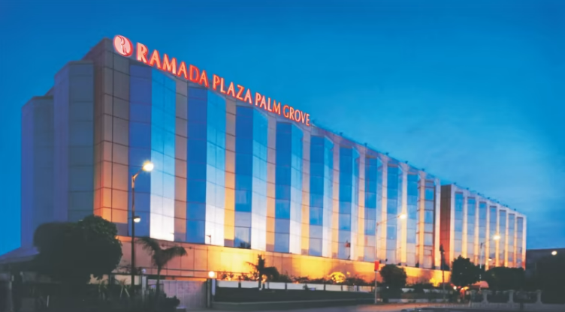
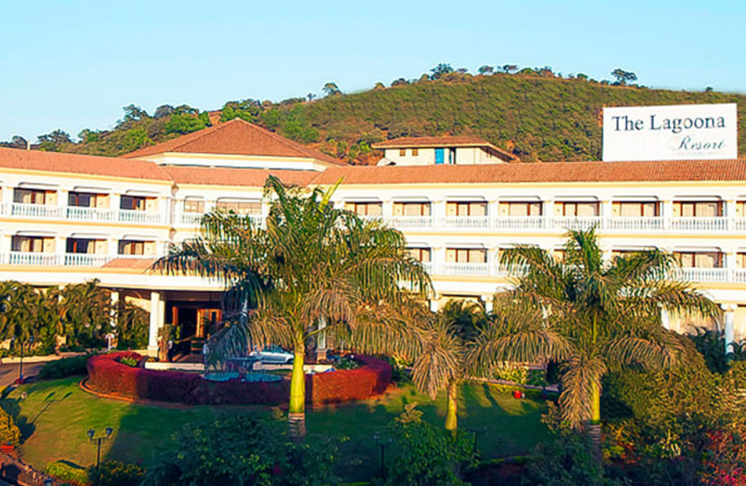
Forecasting Demand for Services
Room Capacity optimization based on DEMAND
How can it be maximized?

Slide 31
Forecasting Demand for Services
High demand during week days
High demand during week ends
Segmenting Demand
In a calendar year, identify the demand (either everyday, weekly, monthly, quarterly, half yearly……).
Capacity is fixed (300 rooms)
Capacity is maximized wrt demand
Generate DEMAND equation

Slide 32
Forecasting Demand for Services
High demand during week days
High demand during week ends
Offering Price Incentives
Positive co-relation between Demand and Price
High demand -> High Price
viz. morning show prices at Movie Theatre
“Water World” prices during summers and other seasons
Revenue Management

Slide 33
Forecasting Demand for Services
High demand during week days
High demand during week ends
Promoting Off-Peak Demand
Generate demand by offering freebies
viz. Come and relax at our “Luxury Suite” at the price of a “Deluxe Room”
Revenue Management

Slide 34
Forecasting Demand for Services
High demand during week days
High demand during week ends
Complementary Services
Pick-up & drop, breakfast, evening snacks etc.

Slide 35
Forecasting Demand for Services
High demand during week days
High demand during week ends
Reservation Systems & Overbooking

Slide 36
Forecasting Demand for Services

